Slide 1
Module 5.4: Browser Isolation

Slide 2
Frame and iFrame
Window may contain frames from different sources
Frame: rigid division as part of frameset
iFrame: floating inline frame
iFrame example
Why use frames?
Delegate screen area to content from another source
Browser provides isolation based on frames
Parent may work even if frame is broken
<iframe src="hello.html" width=450 height=100>
If you can see this, your browser doesn't understand IFRAME.
</iframe>
http://www.w3schools.com/tags/tryit.asp?filename=tryhtml_iframe

Slide 3
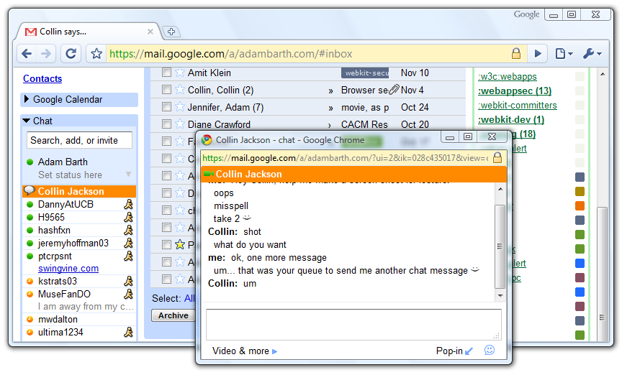
Windows Interact

Slide 4
Analogy
Operating system
Web browser
Primitives
System calls
Processes
Disk
Principals: Users
Discretionary access control
Vulnerabilities
Buffer overflow
Root exploit
Primitives
Document object model
Frames
Cookies / localStorage
Principals: “Origins”
Mandatory access control
Vulnerabilities
Cross-site scripting
Cross-site request forgery
Cache history attacks
…

Slide 5
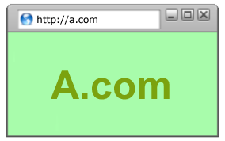
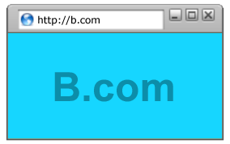
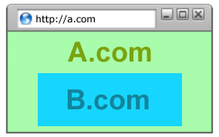
Policy Goals
Safe to visit an evil web site
Safe to visit two pages at the same time
Address bar
distinguishes them
Allow safe delegation

Slide 6
Browser security mechanism
A
A
B
A
B
Each frame of a page has an origin
Origin = protocol://host:port
Frame can access its own origin
Network access, Read/write DOM, Storage (cookies)
Frame cannot access data associated with a different origin

Slide 7
Components of browser security policy
Frame-Frame relationships
canScript(A,B)
Can Frame A execute a script that manipulates arbitrary/nontrivial DOM elements of Frame B?
canNavigate(A,B)
Can Frame A change the origin of content for Frame B?
Frame-principal relationships
readCookie(A,S), writeCookie(A,S)
Can Frame A read/write cookies from site S?
See https://code.google.com/p/browsersec/wiki/Part1
https://code.google.com/p/browsersec/wiki/Part2

Slide 8
Few Words about Browser Side Java Scripts
JavaScript is a relatively simple but rich, object-based imperative scripting language tightly integrated with HTML, and supported by all contemporary web browsers
Browser-side JavaScript is invoked from within HTML documents in four primary ways:
Standalone <SCRIPT> tags that enclose code blocks,
Event handlers tied to HTML tags (e.g. onmouseover="..."),
Stylesheet expression(...) blocks that permit JavaScript syntax in some browsers,
Special URL schemes specified as targets for certain resources or actions (javascript:...) - in HTML and in stylesheets.

Slide 9
Javascript (2)
Regardless of their source (<SCRIPT SRC="...">), remote scripts always execute in the security context of the document they are attached to.
Once called, JavaScript has full access to the current DOM, and limited access to DOMs of other windows;
It may also further invoke new JavaScript by calling eval(), configuring timers (setTimeout(...) and setInterval(...)), or producing JavaScript-invoking HTML.
JavaScript may also configure self to launch when its objects are interacted with by third-party JavaScript code, by configuring watches, setters, or getters, or cross contexts by calling same-origin functions belonging to other documents.

Slide 10
Some Security Relevant Features of Javascript
Dynamic, runtime code interpretation with no strict code caching rules.
Any code snippets located in-line with HTML tags would be interpreted and executed,
JavaScript itself has a possibility to either directly evaluate strings as JavaScript code (eval(...)), or
to produce new HTML that in turn may contain more JavaScript (.innerHTML and .outerHTML properties, document.write(), event handlers).

Slide 11
Security Relevant features of Java Script (2)
Somewhat inconsistent exception support.
when interacting with DOM structures. Depending on the circumstances, some DOM operations may fail silently (with writes or reads ignored), return various magic responses (undefined, null, object inaccessible), throw a non-standardized exception, or even abort execution unconditionally.
Typically synchronous execution.
Within a single document, browser-side JavaScript usually executes synchronously and in a single thread, and asynchronous timer events are not permitted to fire until the scripting engine enters idle state.
No strict guarantees of synchronous execution exist, however, and multi-process rendering of Chrome or MSIE8 may permit cross-domain access to occur more asynchronously.

Slide 12
Cascading Style Sheets (CSS)
Cascading Style Sheets is a simple concept that provides a much more uniform and featured set of tools to alter the visual appearance of any portion of the document, far surpassing the original set of kludgy HTML tag attributes.
A stylesheet outlines visual rendering rules for various functional types of document elements, such as lists, tables, links, or quotations, using a separate block of data with a relatively simple syntax.

Slide 13
Three distinct ways to place CSS directives in HTML documents
The use of an inline STYLE="..." parameter attached to HTML tags of any type; attributes specified this way apply to this and nested tags only
Introduction of a block of CSS code with <STYLE>...</STYLE> in any portion of the document. This block may change the default appearance of any tag, or define named rule sets that may be explicitly applied to specific tags with a CLASS="..." parameter,
Inclusion of a remote style sheet with a LINK REL="stylesheet" HREF="...">, with the same global effect as a <STYLE> block.

Slide 14
Security consequences of attacker controlled style sheets
The risk of JavaScript execution. As a little-known feature, some CSS implementations permit JavaScript code to be embedded in stylesheets.
There are at least three ways to achieve this goal: by using the expression(...) directive, which gives the ability to evaluate arbitrary JavaScript statements and use their value as a CSS parameter; by using the url('javascript:...')directive on properties that support it; or by invoking browser-specific features such as the -moz-binding mechanism of Firefox.
The ability to reuse trusted classes.
If user-controlled CLASS="..." attributes are permitted in HTML syntax, the attacker may have luck "borrowing" a class used to render elements of the trusted UI and impersonate them.

Slide 15





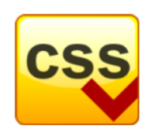
Library import excluded from SOP
<script src=https://seal.verisign.com/getseal?host_name=a.com></script>
Script has privileges of imported page, NOT source server.
Can script other pages in this origin, load more scripts
Other forms of importing
VeriSign

Slide 16

Domain Relaxation
www.facebook.com
chat.facebook.com
Origin: scheme, host, (port), hasSetDomain
Try document.domain = document.domain
www.facebook.com
facebook.com
facebook.com
www.facebook.com
chat.facebook.com

Slide 17
Additional mechanisms
Site A
Site B
Cross-origin network requests
Access-Control-Allow-Origin: <list of domains>
Access-Control-Allow-Origin: *
Cross-origin client side communication
Client-side messaging via navigation (old browsers)
postMessage (modern browsers)
Site A context
Site B context

Slide 18
Communication

Slide 19





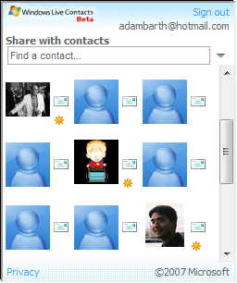

window.postMessage
API for inter-frame communication
Supported in standard browsers
A network-like channel between frames
Add a contact
Share contacts

Slide 20
postMessage syntax
frames[0].postMessage("Attack at dawn!",
"http://b.com/");
window.addEventListener("message", function (e) {
if (e.origin == "http://a.com") {
... e.data ... }
}, false);
Attack at dawn!
Facebook
Anecdote

Slide 21
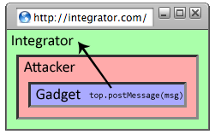
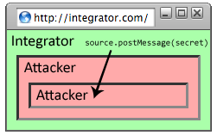
Why include “targetOrigin”?
What goes wrong?
frames[0].postMessage("Attack at dawn!");
Messages sent to frames, not principals
When would this happen?

Slide 22
Navigation

Slide 23
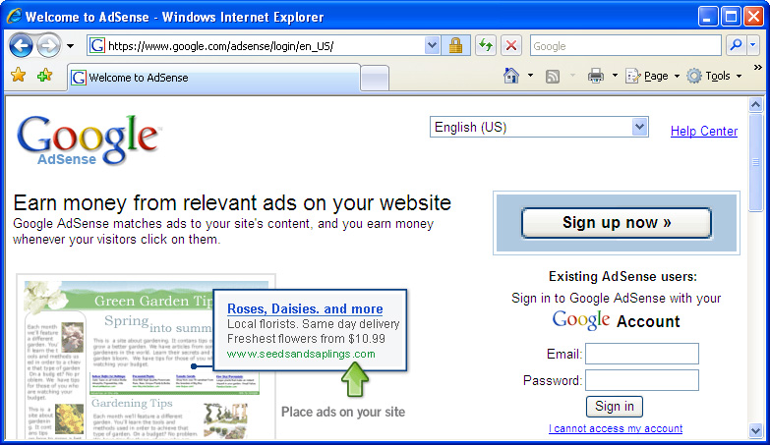
A Guninski Attack
awglogin
window.open("https://attacker.com/", "awglogin");

Slide 24
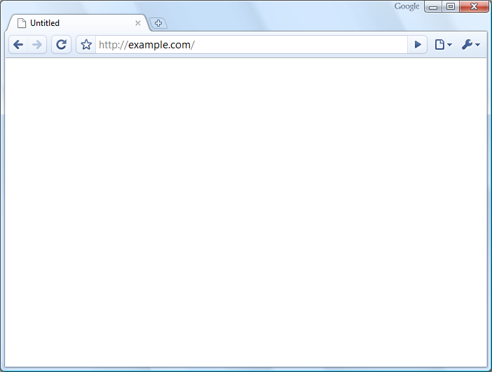
What should the policy be?
Sibling
Frame Bust
Child
Descendant

Slide 25



Legacy Browser Behavior
Browser | Policy
IE 6 (default) | Permissive
IE 6 (option) | Child
IE7 (no Flash) | Descendant
IE7 (with Flash) | Permissive
Firefox 2 | Window
Safari 3 | Permissive
Opera 9 | Window
HTML 5 | Child
Notes:
25

Slide 26
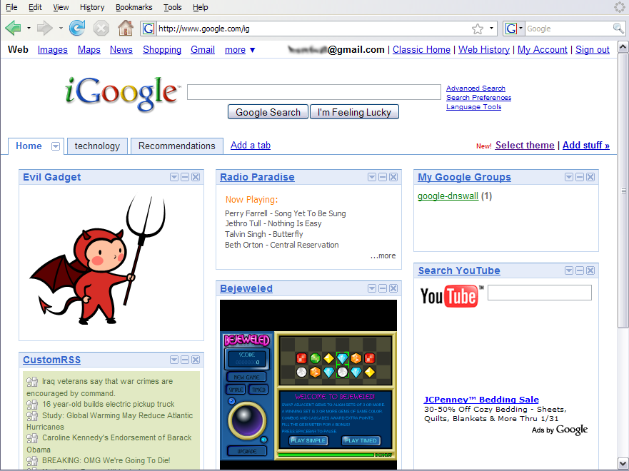
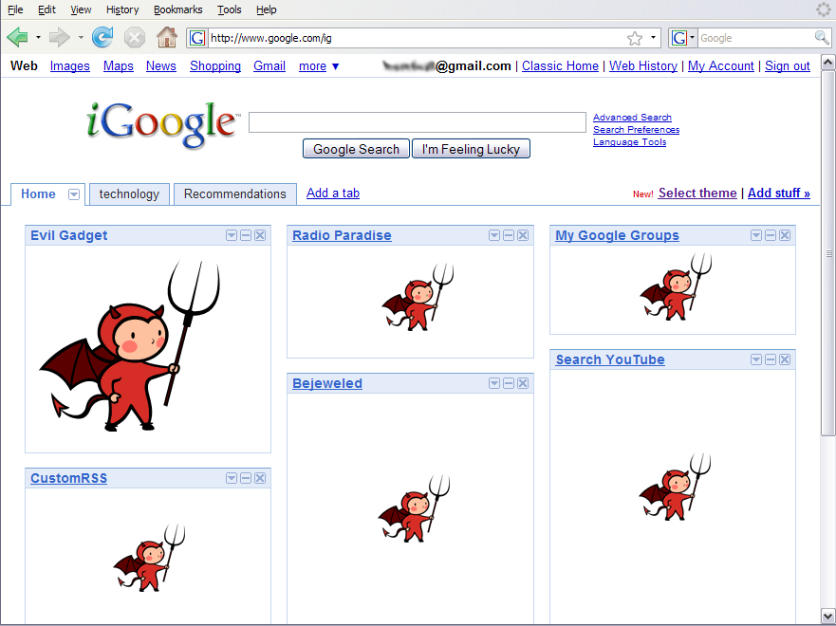
Window Policy Anomaly
top.frames[1].location = "http://www.attacker.com/...";
top.frames[2].location = "http://www.attacker.com/...";
...
Notes:
26

Slide 27
Legacy Browser Behavior
Browser | Policy
IE 6 (default) | Permissive
IE 6 (option) | Child
IE7 (no Flash) | Descendant
IE7 (with Flash) | Permissive
Firefox 2 | Window
Safari 3 | Permissive
Opera 9 | Window
HTML 5 | Child
Notes:
27

Slide 28
Adoption of Descendant Policy
Browser | Policy
IE7 (no Flash) | Descendant
IE7 (with Flash) | Descendant
Firefox 3 | Descendant
Safari 3 | Descendant
Opera 9 | (many policies)
HTML 5 | Descendant

